Slide 1
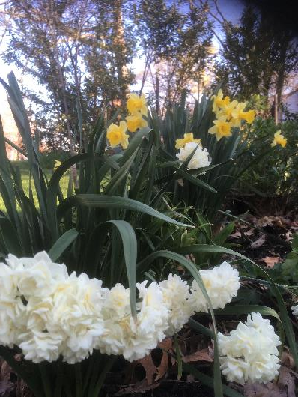
Stations in the Passion of Jesus
Holy Week at St. George’s Episcopal Church
During the Middle Ages, when pilgrims were unable to journey to the Holy Land in order to walk in the footsteps of Jesus and to commemorate his final days in Jerusalem, the church encouraged would be pilgrims to meditate on “stations of the cross.” The stations that follow are meant to be a virtual walking meditation of fourteen stations that depict the Passion of Jesus, starting with his journey from Galilee to Jerusalem to celebrate the Passover, on to his trial and death, and then to his burial in the garden, from which he will rise in the Resurrection.

Slide 2
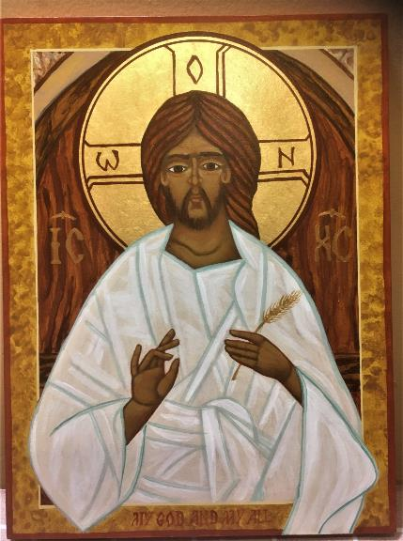
Station One Jesus Predicts His Death
We adore you, O Christ, and we bless you.
Because by your holy cross you have redeemed the world
As Jesus and his disciples travel from Galilee
to Jerusalem for the Passover, Jesus speaks of his death. When Peter refuses to accept this, Jesus says: “If any want to become my followers, let
them deny themselves, take up their cross and follow me.” [Matthew 16: 21-25]
Jesus said: “unless a grain of wheat falls into the earth and dies, it remains just a single grain; but if it dies, it bears much fruit.” John 12:24

Slide 3
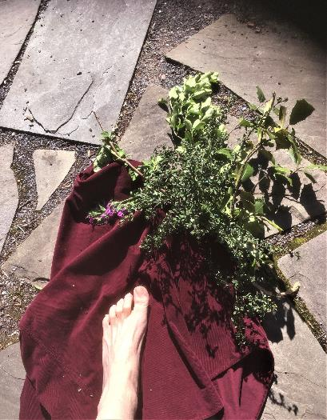
Station Two Jesus Enters Jerusalem
We adore you, O Christ, and we bless you.
Because by your holy cross you have redeemed the world
In Jerusalem Jesus’ followers proclaim him to be
the Messiah, shouting “Blessed is the One who comes in the name of the Lord! Hosanna in the highest!” But the leaders of the Jewish people are disturbed. Jesus proceeds to cleanse the Temple, adding to the leaders’ distress and their fear that Jesus and his followers will cause a riot.
[Matthew 21: 1-16]
You will show me the path of life;
In your presence there is fullness of joy,
and in your right hand are pleasures for evermore.
BCP p 501 from the Committal for a Burial

Slide 4
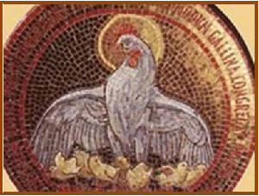
Station Three Jesus Laments for Jerusalem
We adore you, O Christ, and we bless you.
Because by your holy cross you have redeemed the world
As he enters the city Jesus sees himself in the line
of the prophets who have been killed. In a loud
voice he cries: “How often have I desired to gather
your children together as a hen gathers her brood under her wings, and you were not willing!”
[Matthew 23: 37-39]
Listen as God speaks: “Don’t turn a deaf ear as in the Bitter Uprising, as on the day of the Wilderness Test, when your ancestors turned and put God to the test.” Psalm 95:8
“Faith comes from hearing, and hearing through the word of Christ.“ Romans 10:17

Slide 5
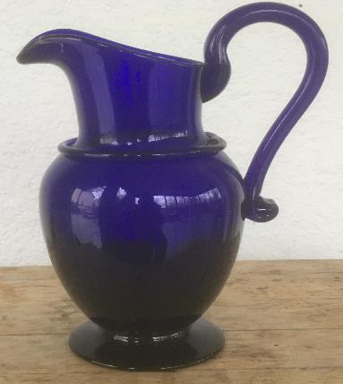
Station Four The Anointing at Bethany
We adore you, O Christ, and we bless you.
Because by your holy cross you have redeemed the world
Two nights before the Passover as Jesus and his followers dine at the home of Simon the Leper, an unnamed woman interrupts the dinner to anoint Jesus for burial. His disciples deny and deflect their fear that he is about to die by objecting to the waste of ointment. Jesus tells them that “she has anointed my body beforehand for its burial.” [Mark 14:1-12]
May we honor the courage of the unnamed woman who came forward, to honestly acknowledge what those close to Jesus could not come to grips with. Gift us with fortitude to be able to face suffering and death. Embolden us to step forward in loving service to those in our midst who suffer sadness and grief.

Slide 6
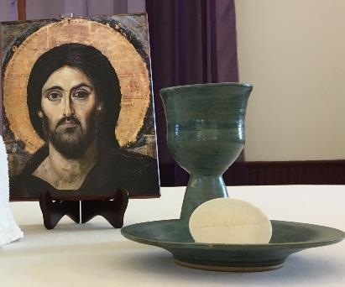
Station Five The Passover Meal
We adore you, O Christ, and we bless you.
Because by your holy cross you have redeemed the world
As Jesus and his disciples gather to observe the Passover and to share a last supper, Jesus blesses bread and wine, and then he speaks in anticipation of his resurrection: “After I am raised up I will go ahead of you to Galilee.” And then Jesus predicts that everyone will abandon him. [Matthew 26: 26-35]
Jesus, I love you above all things, and I desire to receive you into my soul. Though I cannot at this moment receive you sacramentally, come at least spiritually into my heart. I embrace you as if you were already there and unite myself wholly to you. Never permit me to be separated from you. Amen.
St. Alphonsus of Liguori

Slide 7
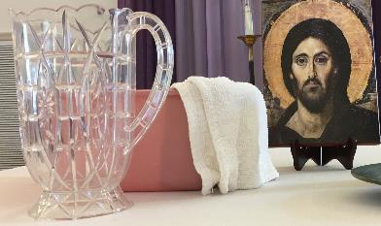
Station Six Jesus Washes the Disciples’ Feet
We adore you, O Christ, and we bless you.
Because by your holy cross you have redeemed the world
Jesus gets up from the table and pours water into a basin to wash his disciples’ feet and dry them with the towel tied around him. This act of service
is meant to express his love for them—even as
Jesus knows of their imminent abandonment
and denial. He proclaims: “I give you a new commandment, to love one another as I have loved you.” [John 13: 4-5]
Jesu, Jesu, fill us with your love,
Show us how to love
The neighbors we have from you.
Ghana Folk Tune
Tr. by Tom Colvin

Slide 8
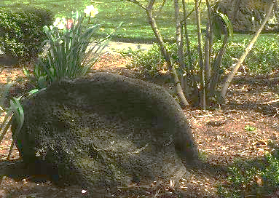
Station Seven Jesus in Gethsemane
We adore you, O Christ, and we bless you.
Because by your holy cross you have redeemed the world
Jesus and his disciples go to the Garden
of Gethsemane to pray. Jesus asks them
to stay awake with him. And then after moving
further into the garden, he prays to God: “If it is possible let this cup pass from me; yet not what I want but what you want.” Finding them asleep when he returns, he says: “ See, the hour is at hand ….my betrayer is at hand,” as Judas and the officers of the Chief Priest come to arrest him. [Matthew 26: 36-56]
Kneel with Jesus at the rock in the garden, feeling his pain and grief. Ask for the grace to discern God’s will at this moment in your life, and be open to follow God’s will resolutely, with confidence and peace.

Slide 9
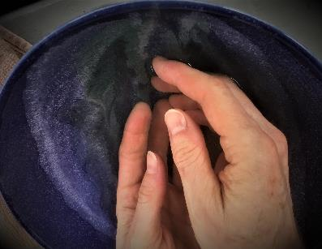
Station Eight: Jesus is Put on Trial
We adore you, O Christ, and we bless you.
Because by your holy cross you have redeemed the world
Accused of blasphemy by the religious leaders,
Jesus is brought to trial before Pilate. Pilate tries to wash his hands of the matter, and acting out of fear, Pilate condemns Jesus and orders his crucifixion.
[Matthew 26: 56 – 27: 26]
Hard it is, very hard, To travel up the slow and stony road
To Calvary, to redeem humankind; far better
To make but one resplendent miracle,
And with a sudden lightening smite the world perfect.
Yet this was not God’s way, Who had the power,
Yet set it by, choosing the cross, the thorn.
The sorrowful wounds. Something there is, perhaps,
That power destroys in passing, something supreme,
To whose great value in the eyes of God
That cross, that thorn, and those five wounds bear witness
Dorothy Sayer

Slide 10
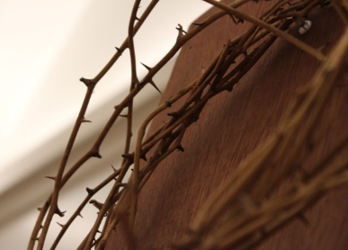
Station Nine: Jesus is Crowned with Thorns
We adore you, O Christ, and we bless you.
Because by your holy cross you have redeemed the world
Pilate’s soldiers strip Jesus, place a scarlet robe and a crown of thorns upon him and then mock him with
the words “Hail, King of the Jews.” Then Jesus is
led out to be crucified. [Matthew 27: 27-31]
To mock your reign, O dearest Lord, they made a crown of thorns;
set you with taunts along that road from which no one returns.
They did not know, as we do now, that glorious is your crown;
that thorns would flower upon your brow, your sorrows heal our own.
A sceptered reed, O patient Lord, they thrust into your hand,
and acted out their grim charade to its appointed end.
They did not know, as we do now, though empires rise and fall,
your Kingdom shall not cease to grow till love embraces all.
F. Pratt Green

Slide 11
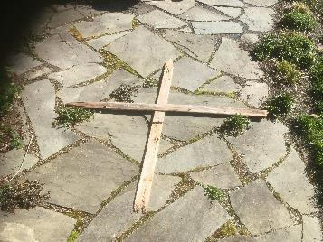
Station Ten: Jesus Carries his Cross to Golgotha
We adore you, O Christ, and we bless you.
Because by your holy cross you have redeemed the world
Along the way up the hill toward the place of
execution, Jesus falls three times under the
burden of the cross. Simon from Cyrene is forced
to carry the cross for Jesus. As Jesus walks toward
Golgotha, he meets a group of women beating
their breasts in lamentation, and he says to them:
“Daughters of Jerusalem, do not weep for me,
but for your children.” [Luke 23: 26-32]
Were you there when they crucified my Lord?
Were you there when they crucified my Lord?
Oh, sometimes it causes me to tremble, tremble, tremble.
Were you there when they crucified my Lord?
Traditional Spiritual

Slide 12
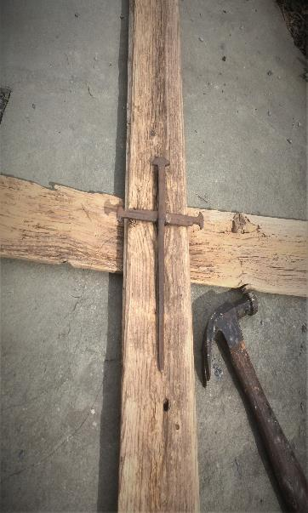
Station Eleven: Jesus is Crucified Alongside Two Others
We adore you, O Christ, and we bless you.
Because by your holy cross you have redeemed the world
Jesus is first stripped and then nailed to a cross. Over the cross a sign reads: This is Jesus of Nazareth, the King of the Jews. The soldiers and crowd mock him:
“If you are the Son of God, come down from the cross.” [Matthew 27: 33-44] Jesus says: “Father, forgive them.
They do not know what they are doing.” To one
of the others dying alongside him, he promises:
“Today, you will be with me in Paradise.” [Luke 23:34]
Were you there when they nailed him to the tree?
Were you there when they nailed him to the tree?
Oh, sometimes it causes me to tremble, tremble, tremble.
Were you there when they nailed him to the tree?
Traditional Spiritual

Slide 13
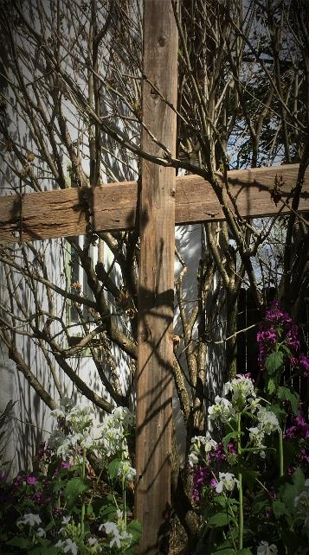
Station Twelve: Jesus Dies on the Cross
We adore you, O Christ, and we bless you.
Because by your holy cross you have redeemed the world
From noon until three the sky darkens over the
whole land, and then Jesus cries, “My God, my God,
why have you forsaken me?” And then he breathes
his last. [Matthew 27: 45-50]
My God, my God, why have you forsaken me?
Why are you so far from helping me,
from the words of my groaning?
O my God, I cry by day, but you do not answer;
and by night, but find no rest.
Yet you are holy, enthroned on the praises of Israel.
In you our ancestors trusted;
they trusted, and you delivered them.
To you they cried, and were saved;
in you they trusted, and were not put to shame.
Psalm 22: 1-5

Slide 14
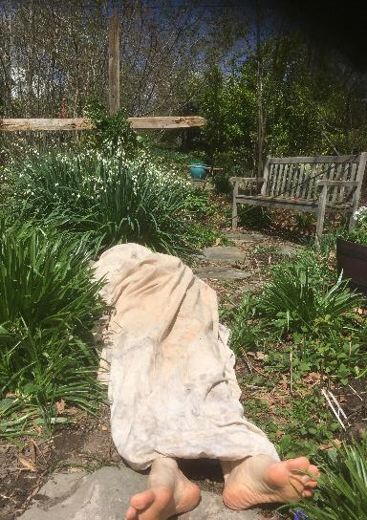
Station Thirteen: Joseph of Arimathea Takes the Body of Jesus from the Cross
We adore you, O Christ, and we bless you.
Because by your holy cross you have redeemed the world
As the women who had followed Jesus from Galilee stand on a hill in the distance, they watch as Joseph of Arimathea takes the body of Jesus from the cross and places Jesus in his own tomb. [Matthew 27: 55-58]
Were you there when they laid him in the tomb?
Were you there when they laid him in the tomb?
Oh, sometimes it causes me to tremble, tremble, tremble.
Were you there when they laid him in the tomb?
Traditional Spiritual

Slide 15
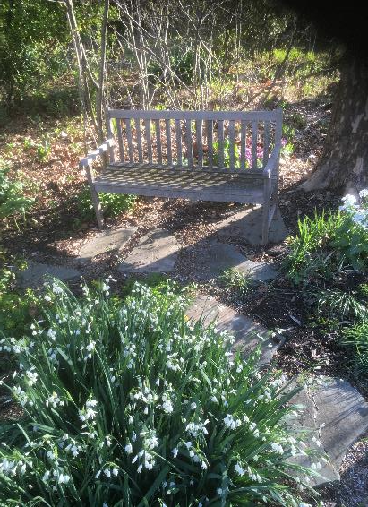
Station Fourteen: Mary Magdalene and the Other Women do Vigil at the Tomb
We adore you, O Christ, and we bless you.
Because by your holy cross you have redeemed the world
And when the stone had been rolled into
place, the women follow to that place to sit
opposite the tomb. [Matthew 27: 59-61]
May we summon the courage to follow Jesus in his way of the Cross by embracing our fears and allowing the experience of lamentation to feed our souls. Give us the strength, O God, to face the pain we may feel and to sit with peace with impending grief. For we live in joyful, faithful anticipation of the Resurrection.

